Slide 1
SESSION 5 Uninformed Search Strategies(Continued...) & Informed Search Strategies (Heuristic Search Techniques)

Slide 2
Session Outcomes
Student will learn several general-purpose search algorithms that can be used to solve these problems.

Slide 3
Iterative deepening depth-first Search (IDDFS)
Iterative deepening search (or iterative deepening depth-first search) is a general strategy, often used in combination with depth-first tree search, that finds the best depth limit.
This search algorithm finds out the best depth limit and does it by gradually increasing the limit until a goal is found.
In general, iterative deepening is the preferred uninformed search method when the search space is large and the depth of the solution is not known.

Slide 4
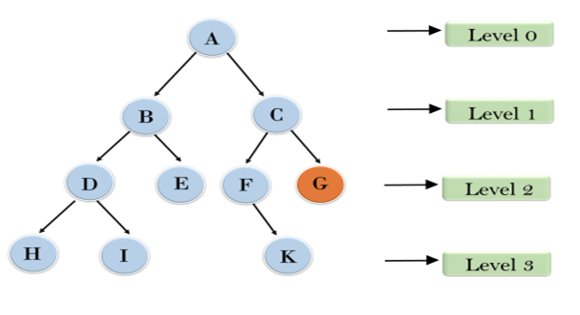
Iterative deepening depth-first Search(continued….)
Example:
1'st Iteration-----> A
2'nd Iteration----> A, B, C
3'rd Iteration------>A, B, D, E, C, F, G
In thrid iteration the algorithm will find the gold node i.e., G.

Slide 5
Iterative deepening depth-first Search(continued….)
Completeness: This algorithm is complete is if the branching factor is finite.
Time Complexity: Let's suppose b is the branching factor and depth is d then the worst-case time complexity is O(b^{d}).
Space Complexity: The space complexity of IDDFS will be O(bd).
Optimality: IDDFS algorithm is optimal if path cost is a non- decreasing function of the depth of the node.

Slide 6
Iterative deepening depth-first Search(continued….)
Advantages:
It combines the benefits of BFS and DFS search algorithm in terms of fast search and memory efficiency.
Like DFS, Its memory requirement is modest.
Disadvantages:
Some times, Iterative deepening search may seem wasteful because states are generated multiple times. It turns out this as too costly.

Slide 7
Bidirectional Search
Bidirectional search algorithm runs two simultaneous searches, one form initial state called as forward-search and other from goal node called as backward-search, to find the goal node.
Bidirectional search replaces one single search graph with two small sub-graphs in which one starts the search from an initial vertex and other starts from goal vertex. The search stops when these two graphs intersect each other.
Bidirectional search can use search techniques such as BFS, DFS, DLS, etc.

Slide 8
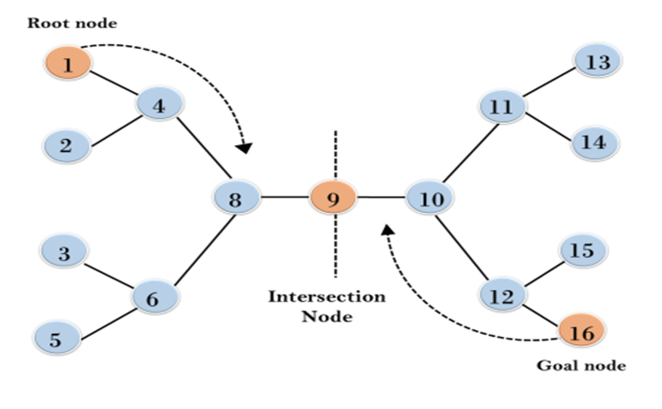
Bidirectional Search(Continued……)
Example:

Slide 9
Bidirectional Search(Continued……)
Completeness: Bidirectional Search is complete if we use BFS in both searches.
Time Complexity: Time complexity of bidirectional search using BFS is O(b^{d/2}).
Space Complexity: Space complexity of bidirectional search is O(b^{d/2}).
Optimal: Bidirectional search is Optimal

Slide 10
Bidirectional Search(Continued……)
Advantages:
Bidirectional search is fast.
Bidirectional search requires less memory
Disadvantages:
Implementation of the bidirectional search tree is difficult.
In bidirectional search, one should know the goal state in advance.

Slide 11
INFORMED SEARCH STRATEGIES
(Heuristics Search Techniques)
Informed search strategy is one that uses problem-specific knowledge beyond the definition of the problem itself—can find solutions more efficiently than can an uninformed strategy.
We learn the following two strategies as part of Informed Search Strategies. We discuss GBFS in this session and A* algorithm in the following session:
Greedy Best First Search
A* search

Slide 12
Heuristic Search
All of the search methods in the preceding section are uninformed in that they did not take into account the cost incurred to reach the goal.
They do not use any information about where they are trying to get to unless they happen to stumble on a goal.
One form of heuristic information about which nodes seem the most promising is a heuristic function h(n), which takes a node n and returns a non-negative real number that is an estimate of the path cost from node n to a goal node.
The function h(n) is an underestimate if h(n) is less than or equal to the actual cost of a lowest-cost path from node n to a goal.

Slide 13
Greedy best-first search
Greedy best-first search tries to expand the node that is closest to the goal, on the grounds that this is likely to lead to a solution quickly. Thus, it evaluates nodes by using just the heuristic function; that is, f (n) = h(n).
The algorithm is called "greedy“ because at each step it tries to get as close to the goal as it can.
Greedy Best First search using h_{SLD} finds a solution without ever expanding a node that is not on the solution path; hence, its search cost is minimal.

Slide 14
Greedy Best First Search(Continued….)
Algorithm:
1. Start with OPEN containing just the initial state
2. Until a goal is found or there are no nodes left on OPEN do:
Pick the best node on OPEN
Generate its successors
For each successor do:
If it has not been generated before, evaluate it, add it to OPEN, and record its parent.
If it has been generated before, change the parent if this new path is better than the previous one. In that case, update the cost of getting to this node and to any successors that this node may already have.

Slide 15
Greedy Best First Search(Continued….)
Explanation:
It proceeds in steps, expanding one node at each step, until it generates a node that corresponds to a goal state.
At each step, it picks the most promising of the nodes that have so far been generated but not expanded.
It generates the successors of the chosen node, applies the heuristic function to them, and adds them to the list of open nodes, after checking to see if any of them have been generated before.
By doing this check, we can guarantee that each node only appears once in the graph, although many nodes may point to it as a successor.

Slide 16
Greedy Best First Search(Continued….)
Heuristic function h(n)= estimated as cost of the cheapest path from the state at node n to a goal state, i.e., h(n)=straight line distance
hsld cannot be computed from the problem description itself
Its search cost is minimal(Search cost is very low but not lowest). However, it is not optimal.
The worst-case time and space complexity for the tree version is O(d^{m} ), where m is the maximum depth of the search space.

Slide 17
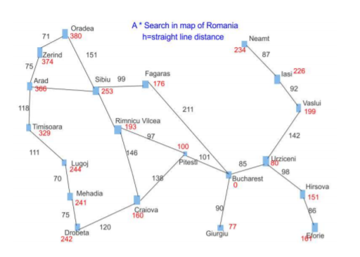
Greedy Best First Search(Continued….)
Example:
Consider the following Romania map:
Goal is to find a path from Arad to Bucharest.
140
80

Slide 18
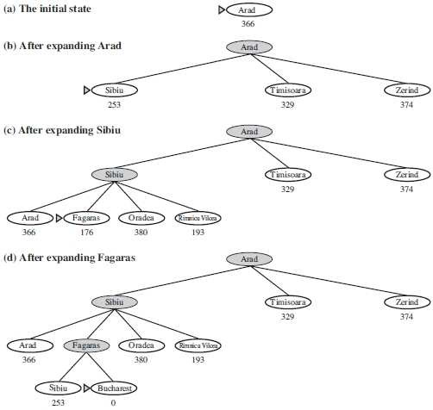
Greedy Best First Search(Continued….)

Slide 19
Greedy Best First Search(Continued….)
Advantages:
GBFS mostly finds a solution without ever expanding a node that is not on the solution path; hence, its search cost is minimal.
Greedy best-first search tries to expand the node that is closest to the goal, on the grounds that this is likely to lead to a solution quickly.
Disadvantages:
Greedy best-first tree search is incomplete even in a finite state space. For Eg., Consider the problem of getting from Iasi to Fagaras. The heuristic sug- gests that Neamt be expanded first because it is closest to Fagaras, but it is a dead end.
End of session

